Slide 1
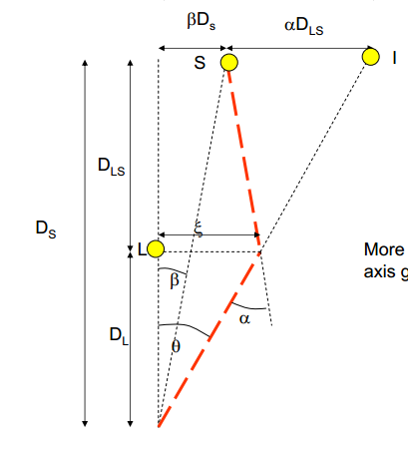
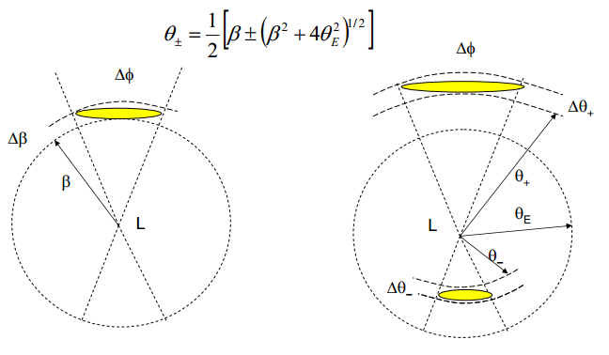
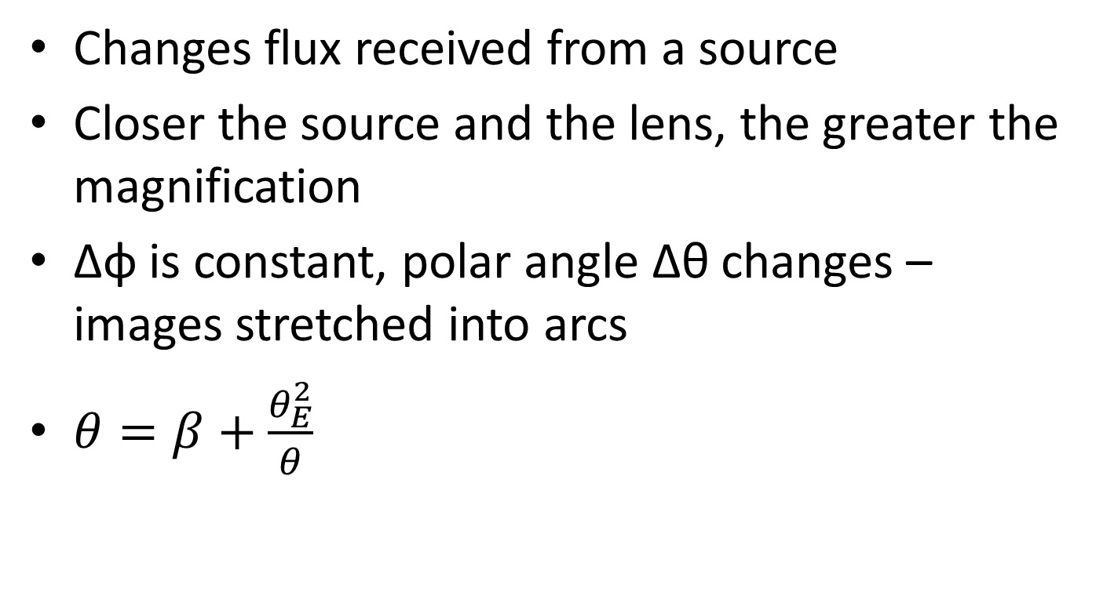
Gravitational Lensing
Changes flux received from a source
Closer the source and the lens, the greater the magnification
Δφ is constant, polar angle Δθ changes – images stretched into arcs
$θ=β+\frac{θ_{E}^{2}}{θ}$

Slide 2
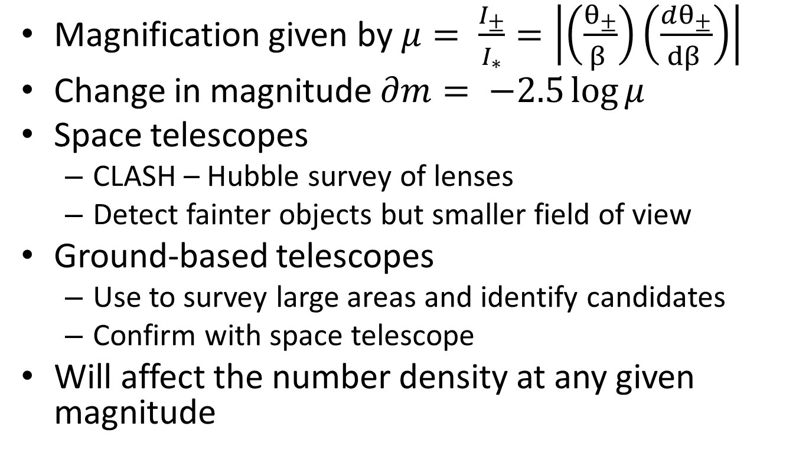
Gravitational Lensing
Magnification given by $μ= \frac{I_{±}}{I_{∗}}=\left|\left(\frac{θ_{±}}{β }\right)\left(\frac{dθ_{±}}{dβ }\right)\right|$
Change in magnitude $∂m= −2.5\log{μ}$
Space telescopes
CLASH – Hubble survey of lenses
Detect fainter objects but smaller field of view
Ground-based telescopes
Use to survey large areas and identify candidates
Confirm with space telescope
Will affect the number density at any given magnitude

